Slide 1


Clustering Credit Card Accounts
Evan Edmunds

Slide 2
Background
Data-driven decisions are ones that rely on analytics, domain knowledge, people, and problem-solving to achieve desired outcomes.
Data alone is not enough to make these data-driven decisions as data first needs to be gathered, cleaned, and processed before it is useful.
Processes and workflows must be put into place that can properly manage data for it to provide useful insights.

Slide 3
purpose
Segment data into groups of data points that share similar characteristics with each other.
Use these groups to define clusters of data that will then act as labels for these groups.
These labels will then have a variety of uses in analyzing current and future data: determining targeted approaches to customers based on their cluster, examine statistics of each group, and label future data so that accounts are handled more effectively.

Slide 4
Data
The dataset used in this project contains sample data that pertains to customer accounts for credit cards over a 6-month period.
There were a total of 17 variables in this dataset that covered different aspects of accounts and their habits.
These variable included both numerical and binary data

Slide 5
Data exploration
The summary statistics were examined for each variable in the dataset including mean, standard deviation, min, quartile, and max values.
Missing values were totaled for all variables and there were 313 missing values for the MINIMUM_PAYMENTS variable and 1 missing value for the CREDIT_LIMIT variable.
Skew and kurtosis values were examined for all variables as well.
Based on the summary statistics, skew, and kurtosis data, it is evident that the distributions of the data are highly affected by outliers.

Slide 6
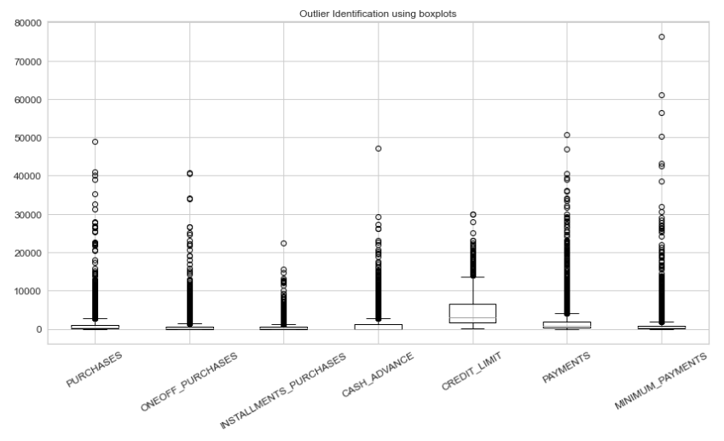
Outlier presence in data

Slide 7
Data cleaning
Extreme outliers were removed by creating custom thresholds using the boxplot of the previous slide.
After the removal of these outliers 8,625 observations remained.
No missing data remained in the MINIMUM_PAYMENTS variable
The missing value in the CREDIT_LIMIT variable was imputed using median imputation.

Slide 8
preprocessing
The data was standardized so that each variable had a mean of 0 and a standard deviation of 1.
Data also underwent Principal component analysis to reduce the number of dimensions that the algorithms would use in their calculations.

Slide 9
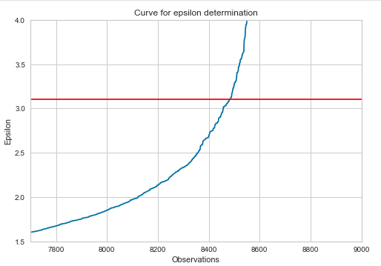
modeling
K means and DBSCAN models were chosen for this clustering task. And Silhouette score was used to evaluate their performance.
The number of clusters for the k means model was done using iterative testing and monitor of silhouette scores
The minimum points and epsilon hyperparameters for the DBSCAN model were done using a graph of nearest neighbors plotted against observations and a rule of thumb given by relevant literature (Mullin, 2020).

Slide 10
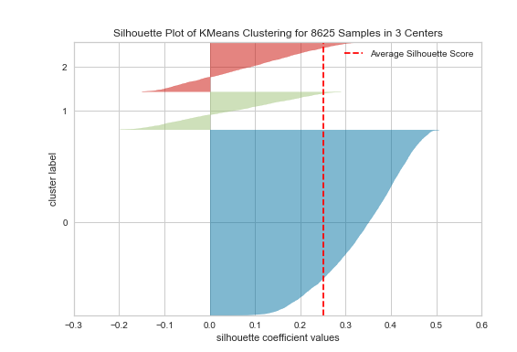
results
The silhouette scores for the DBSCAN and k means model were .580 and .251, respectively.
However, the DBSCAN model only separated the data in to one cluster, and noise points, effectively failing the task.
The k means model had an average positive score, indicating successful clustering in somewhat sparse clusters.

Slide 11
Final remarks
The k means model was able to successfully cluster the data into distinct groups.
While some of the clusters contain sparse data, the clusters can be used to examine the data in more detail and perform supervised learning algorithms as well.
It is possible that clusters will improve with more data collected over time.

